Slide 1
Development Platform
Shahriar’s Analytical Academy

Slide 2
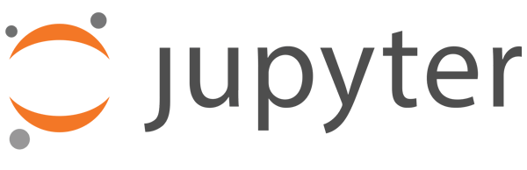
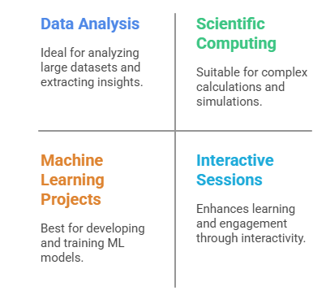
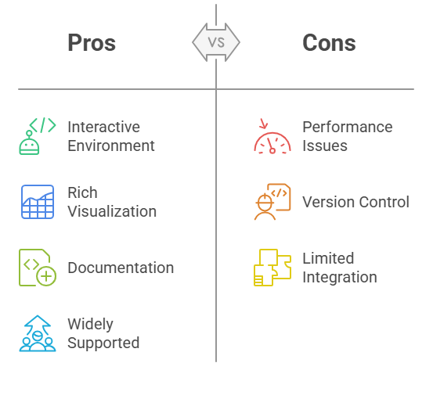
Jupyter Notebook
Jupyter Notebook is an open-source, web-based application that allows users to create and share documents that contain live code, equations, visualizations, and narrative text. It supports over 40 programming languages, including Python, R, and Julia.
Notes:
Jupyter Notebook is an open-source, interactive web-based application used for creating and sharing documents. These documents can contain live code, equations, visualizations, and narrative text. It's widely popular among data scientists, researchers, and educators. It supports various programming languages, including Python, R, and Julia, making it versatile for many applications.
When to Use It? Jupyter Notebook is ideal for interactive data analysis, scientific computing, and machine learning projects. It's great for when you need to run code step by step, make quick adjustments, and visualize results in real-time. It's also excellent for tutorials, data exploration, and sharing research findings in an interactive format.
Advantages:
Interactive Environment: Jupyter allows running code in segments (cells), so you can view results instantly without running the entire script. This is extremely useful for debugging and experimenting.
Rich Visualization: It integrates well with visualization libraries like Matplotlib, Seaborn, and Plotly, allowing users to create graphs and visual representations of their data.
Documentation: You can mix code, text, and visualizations all in one document. This makes it easy to document the process and explain your findings, which is helpful for both learning and collaboration.
Widely Supported: Since Jupyter is widely used, it has a large community, which means plenty of resources and support for users.
Disadvantages:
Performance Issues: As the dataset grows, Jupyter can become slower, especially when dealing with large-scale computations or big data.
Version Control: Managing a large codebase with many team members can be difficult. Jupyter notebooks are not the best when it comes to version control, as they contain a mix of code, outputs, and text.
Limited Integration: Some advanced integrations with certain libraries or tools might not work as smoothly compared to traditional IDEs (Integrated Development Environments), making it less suitable for certain complex projects.

Slide 3
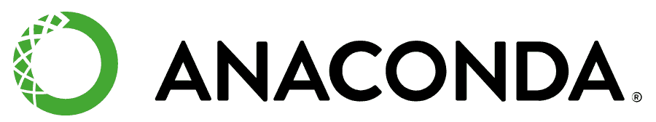
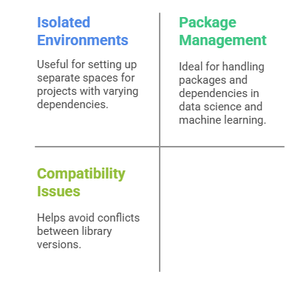
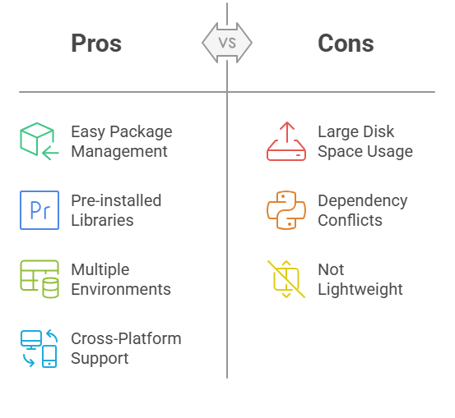
Anaconda
Anaconda is a free and open-source distribution of Python and R, widely used for scientific computing, data science, and machine learning. It comes with a package manager (Conda) and an environment manager for handling dependencies and environments.
Notes:
Anaconda is a free, open-source distribution of Python and R designed for scientific computing, data science, and machine learning. It comes with a package manager called Conda and a virtual environment manager to simplify dependency management and package installations. It’s a comprehensive platform that makes it easier to work with different data science libraries.
When to Use It? Anaconda is best used when you need to create isolated environments for different projects, each with its own set of dependencies. It’s especially useful in data science and machine learning, where managing multiple libraries and packages can get tricky. It's also perfect for avoiding compatibility issues between packages and ensuring that each project is self-contained.
Advantages:
Easy Package Management: Conda simplifies installing and managing libraries, making the setup process much easier than traditional methods.
Pre-installed Libraries: Anaconda comes with most of the popular data science libraries, like Pandas, NumPy, SciPy, TensorFlow, and Matplotlib, already installed.
Multiple Environments: You can create and manage multiple environments, ensuring that dependencies for different projects do not interfere with each other.
Cross-Platform Support: Anaconda is available on Windows, macOS, and Linux, ensuring compatibility across different operating systems.
Disadvantages:
Large Disk Space Usage: Anaconda is known for being large in size, which can be inefficient if you're working on a small project or have limited disk space.
Dependency Conflicts: Despite Conda’s package management, sometimes issues with library dependencies can still arise, especially when using libraries that don’t work well with Conda.
Not Lightweight: Anaconda is designed for data science, so for smaller or simpler projects, it may feel bulky and cumbersome.

Slide 4
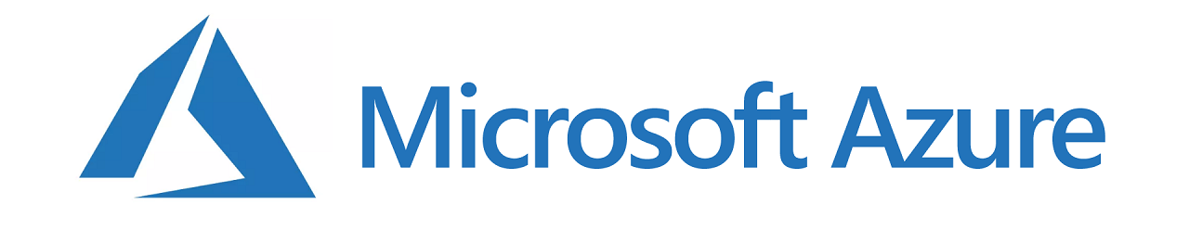
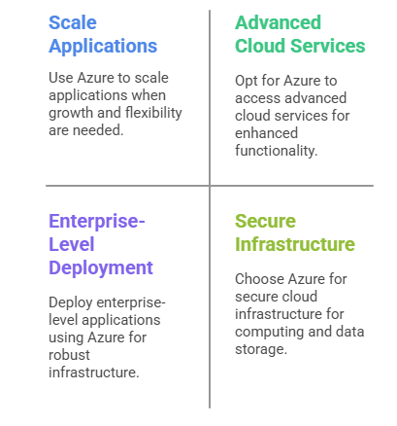
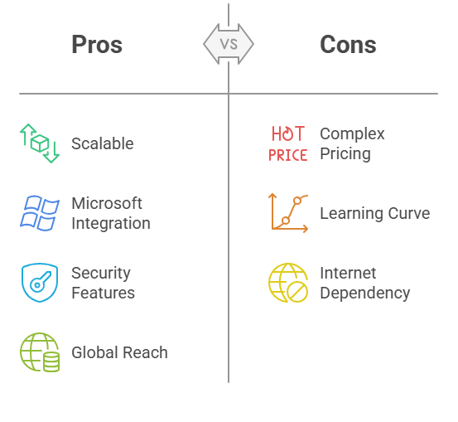
Microsoft Azure
Microsoft Azure is a cloud computing platform offering a variety of cloud services, including computing, analytics, storage, and networking. It provides a wide range of services for building, deploying, and managing applications through Microsoft-managed data centers.
Notes:
Microsoft Azure is a comprehensive cloud computing platform offering services like computing, analytics, storage, and networking. It's a highly scalable platform that allows users to build, deploy, and manage applications through a network of Microsoft-managed data centers. Azure is widely used for enterprise-level applications, data storage, and big data analytics.
When to Use It? Azure is ideal when you need to scale your applications and access advanced cloud services. It's especially useful for businesses looking for secure infrastructure to host applications, store data, and perform complex computations. Azure is also commonly used for deploying enterprise applications and managing big data.
Advantages:
Scalable: Azure offers flexible scalability, so you can adjust resources based on the needs of your application or business.
Integration with Microsoft Products: It integrates well with other Microsoft tools like Office 365, Dynamics 365, and SQL Server, making it a good choice for businesses already using Microsoft products.
Security: Azure offers robust security features, such as encryption, firewalls, and advanced access management systems to ensure data safety.
Global Reach: Azure has data centers all over the world, ensuring high availability and low latency.
Disadvantages:
Complex Pricing Model: The pricing structure can be difficult to understand and predict, especially for businesses with fluctuating usage needs.
Learning Curve: Due to the vast number of services and configurations, it can be overwhelming for beginners or users without a cloud computing background.
Dependence on Internet Connection: As a cloud platform, you need a stable internet connection to access your resources. Without it, Azure services won’t be available.

Slide 5

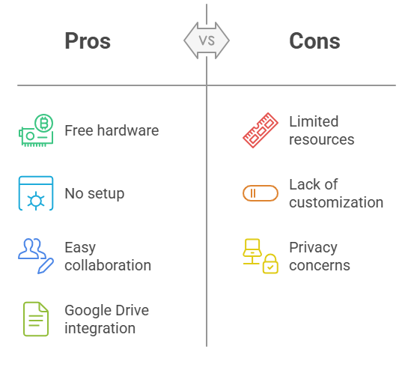
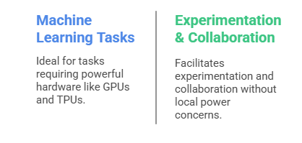
Google colab
Google Colab is a free cloud-based platform for coding in Python, offering GPU/TPU support for faster computation. It's a Jupyter-like notebook environment hosted by Google, allowing you to write and execute Python code in a browser without setup.
Notes:
Google Colab is a free cloud-based platform for Python programming that provides GPU/TPU support for faster computation. It is essentially a Jupyter Notebook environment hosted by Google, which means you can write and execute Python code in a browser without needing to install anything on your local machine.
When to Use It? Google Colab is perfect for machine learning, deep learning, and data analysis tasks, especially when you need access to powerful hardware like GPUs or TPUs for free. It’s also great for running experiments or collaborating with others in a cloud-based environment.
Advantages:
Free Access to GPUs/TPUs: Google Colab gives you free access to hardware accelerators like GPUs and TPUs, making it ideal for heavy computations.
Cloud-Based: Since it runs directly in your browser, no installation or setup is needed. You can access your notebooks from any device.
Collaboration: You can easily share your Colab notebooks with others, enabling real-time collaboration.
Integration with Google Drive: Colab integrates with Google Drive, so you can easily store and access your notebooks.
Disadvantages:
Limited Resources: The free version of Colab has limits on RAM and GPU/TPU usage, and your session might expire after a certain period of inactivity.
Lack of Customization: Compared to local setups, Colab has some restrictions in terms of installing certain libraries or dependencies.
Privacy Concerns: Since data is stored on Google’s servers, there may be concerns regarding the privacy and security of sensitive information.

Slide 6
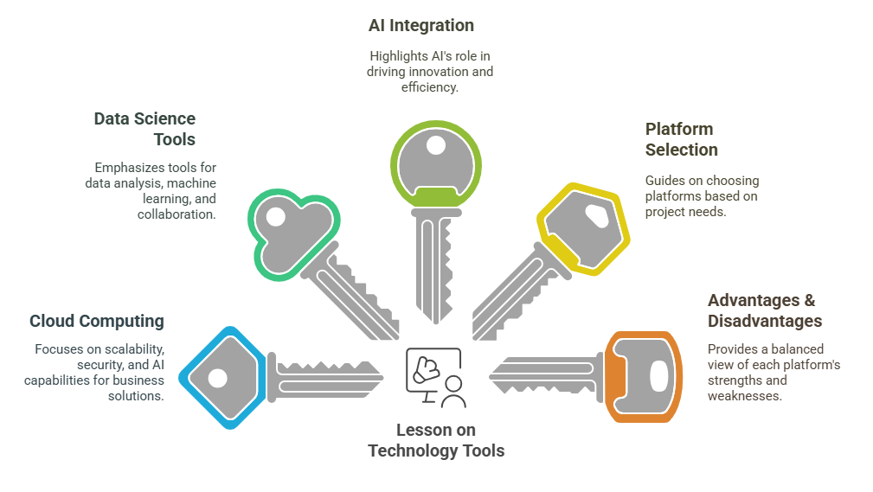
5 Key Learning Points of this Lesson
Notes:
Cloud Computing Platforms: Learn about cloud services such as Microsoft Azure and IBM Watson, which offer scalable, secure infrastructure and advanced AI capabilities to support business solutions.
Data Science Tools: Understand the importance of platforms like Jupyter Notebook, Anaconda, and Google Colab in simplifying data analysis, machine learning, and research workflows.
AI Integration: Discover how AI technologies like IBM Watson are transforming industries such as healthcare and finance, helping businesses make smarter decisions.
Platform Selection: Know when to use platforms like Anaconda and Google Colab based on the needs of your project (e.g., large datasets, machine learning, or cost efficiency).
Advantages & Disadvantages: Consider the strengths and limitations of each platform to make informed decisions based on the requirements of your project or business.

Slide 7
Thank You!
Shahriar’s Analytical Academy

